Slide 1
Split-belt Paper (Fig. from Lit)

Slide 2
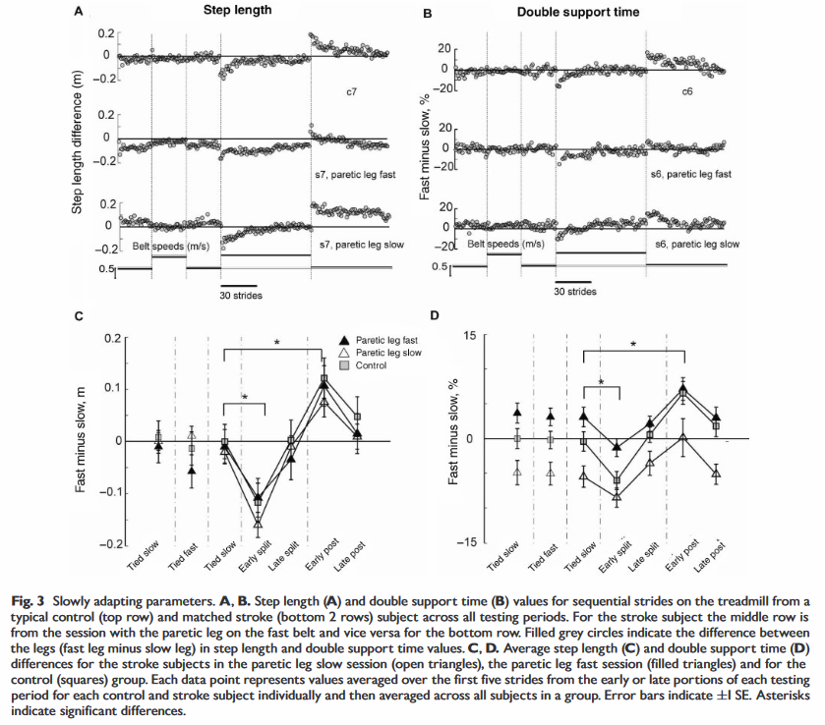
Other peoples’ split belt data
Reisman,...Bastian:
Locomotor adaptation on a split-belt treadmill can improve walking symmetry post-stroke
Asym < 0.2
patients

Slide 3
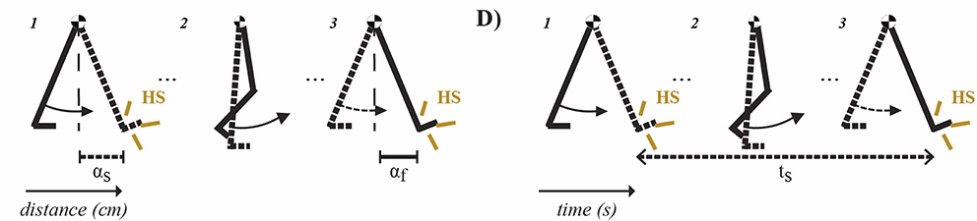
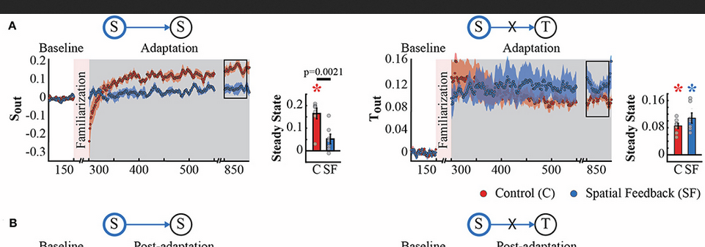
Other peoples’ split belt data
Gonzalez-Rubio,..., Torres-Oveido
Explicit control of step timing during split-belt walking reveals interdependent recalibration of movements in space and time
Faster adaptation with spacial feedback
SF = spatial feedback; TF = temporal feedback
Asym in control: ~0.2
S_out = asym of step position
T_out = asym of step timing
Don’t know if step position tracks with steplength (but I think it should?)

Slide 4
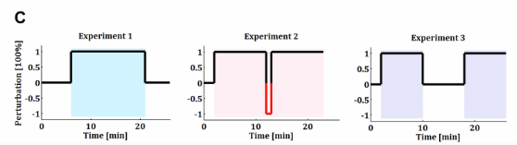
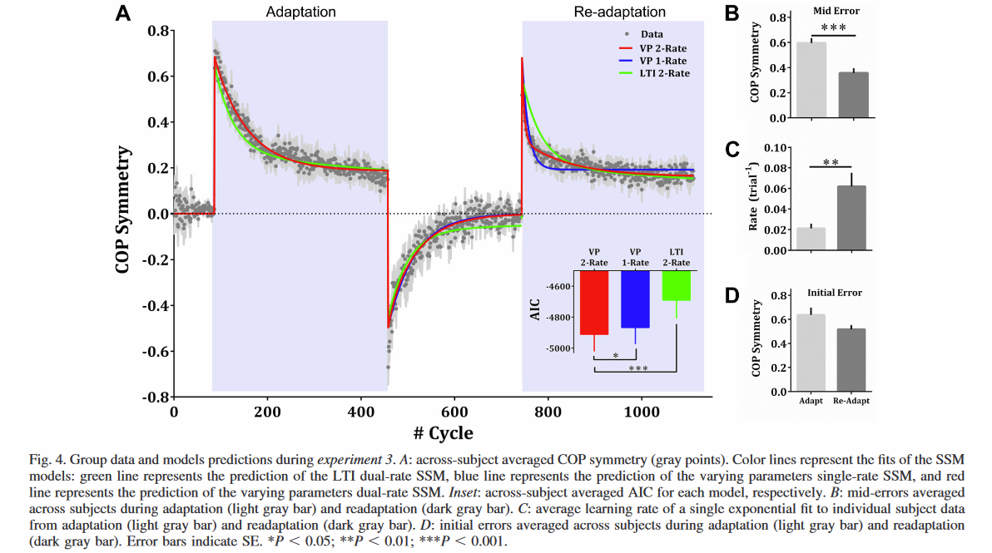
Other peoples’ split belt data
Mawase,...,Karniel
Savings in locomotor adaptation explained by changes in learning parameters following initial adaptation
3 exp: 1) continuous adaptation, 2) 2 adaptation with 30s counter perturbation, 3)2 adaptation with tied washout
Don’t know if adaptation in COP changes in parallel with steplength adaptation

Slide 5
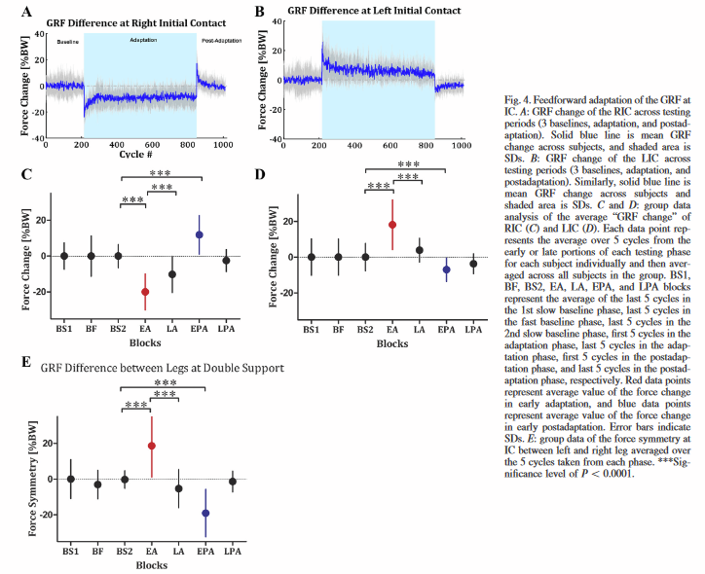
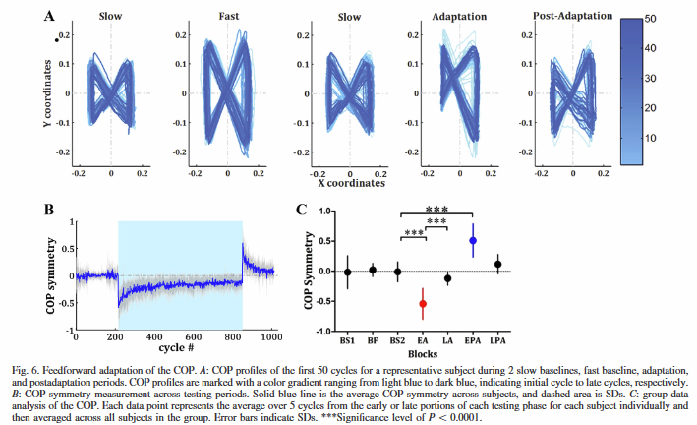
Other peoples’ split belt data
Mawase,...,Karniel
Kinetic adaptation during locomotion on a split belt treadmill
Baseline adaptation and post adaptation; belts stopped between phases
Kinetic focus so GRF and COP reported
Dominant (right) always on fast condition (GRF increased for fast and decreased for slow
Don’t know if adaptation in COP or GRF changes in parallel with steplength adaptation

Slide 6
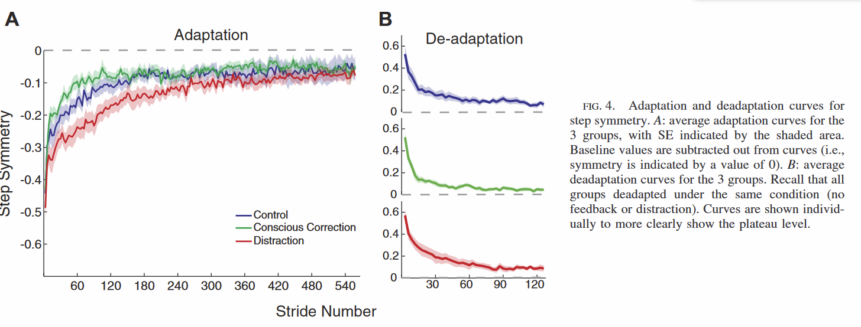
Other peoples’ split belt data
Malone and Bastian
Thinking about walking: effects of conscious correction versus distraction on locomotor learning
Also looked at center of oscillation (similar plot) and phasing (no difference btw groups

Slide 7
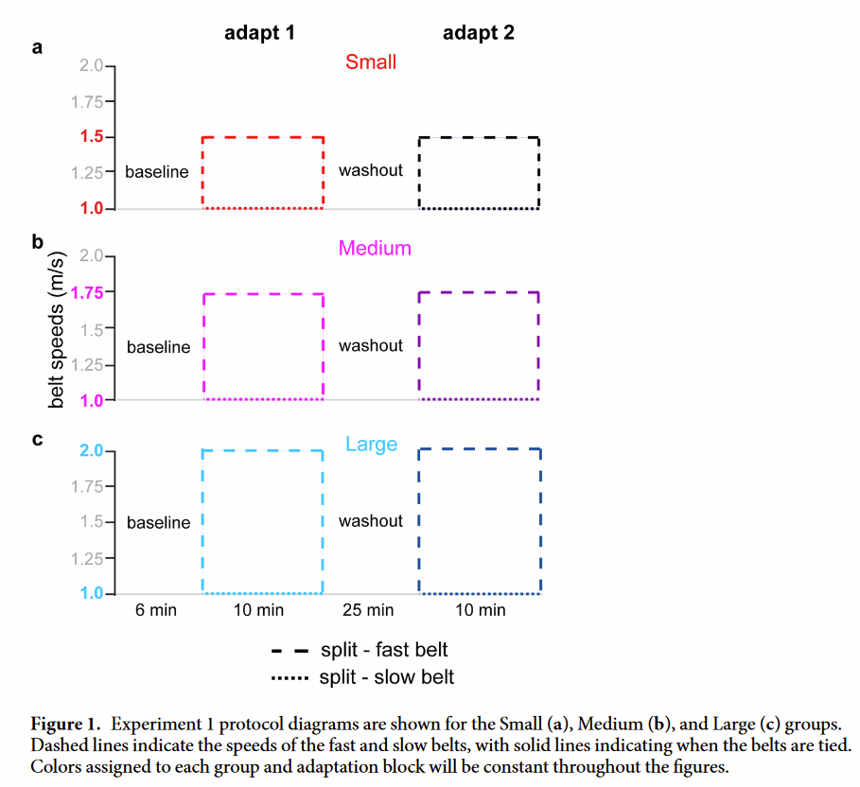
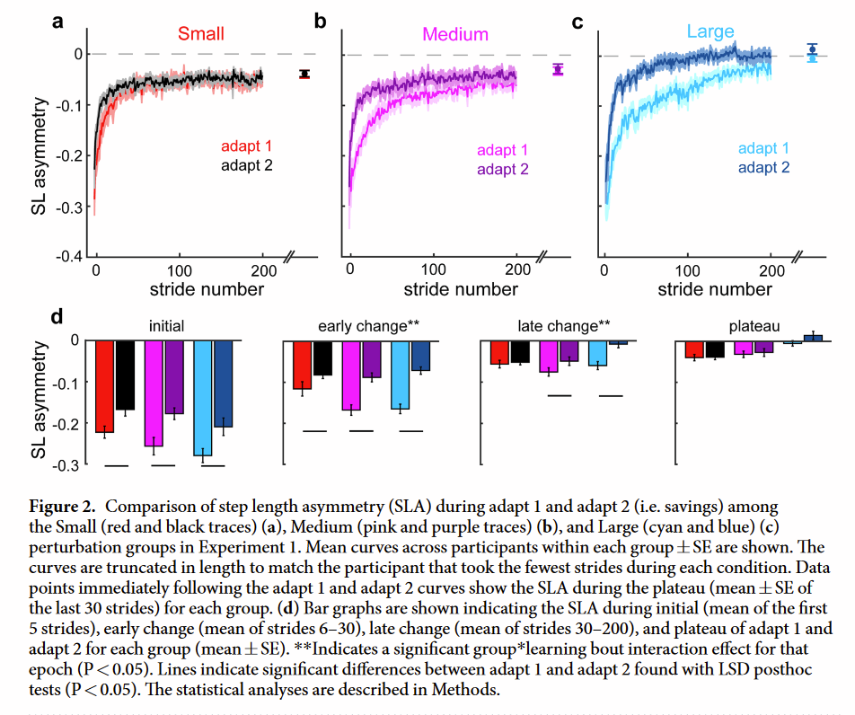
Other peoples’ split belt data
Maybe its not so much that savings is faster, but that the initial adaptation is slower?
Leech, Roemmich, Bastian
Creating flexible motor memories in human walking
For first exposure, we have similar initial asymmetry, but none of our savings show similar initial asymmetry.
Possible reasons:
Insufficient washout
Too slow acceleration into split
Verbal warning of upcoming split
Something about sudden transition reduces asym

Slide 8
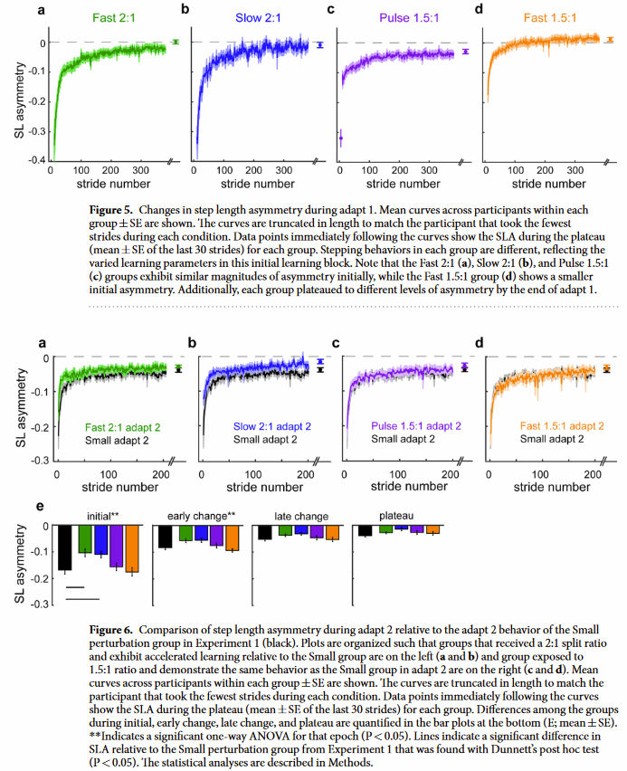
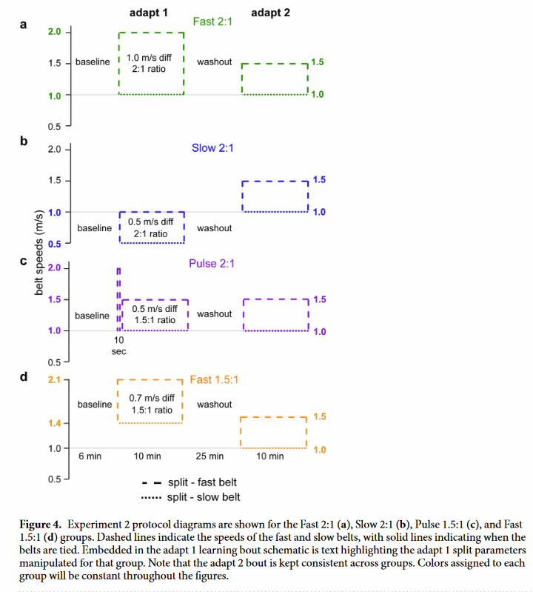
Other peoples’ split belt data
Importance of belt speed ratio
Leech, Roemmich, Bastian
Creating flexible motor memories in human walking

Slide 9
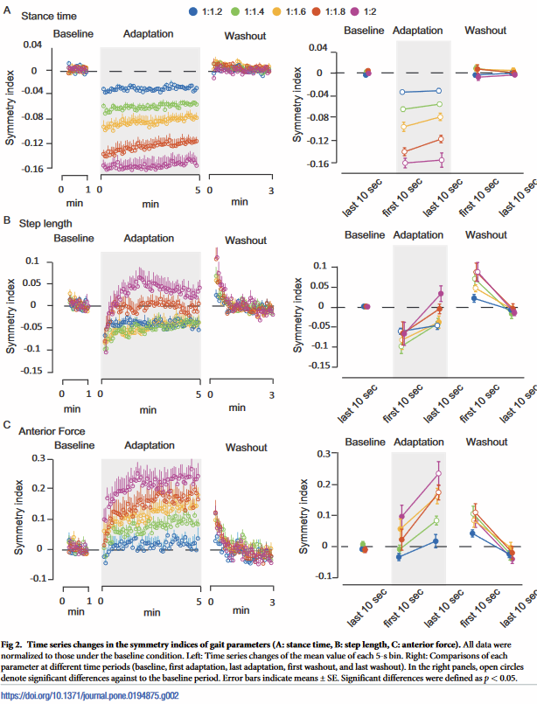
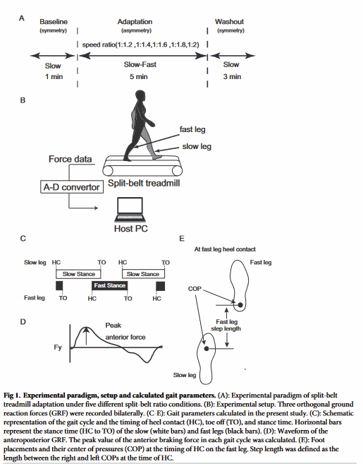
Other peoples’ split belt data
Yokoyama,...Kawashima
Characteristics of the gait adaptation process due to splitbelt treadmill walking under a wide range of right-left speed ratios in humans

Slide 10
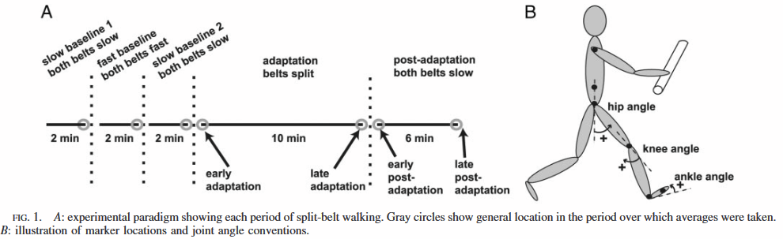
Other peoples’ split belt data
Reisman, Block, Bastian
Interlimb coordination during locomotion: what can be adapted and stored?

Slide 11
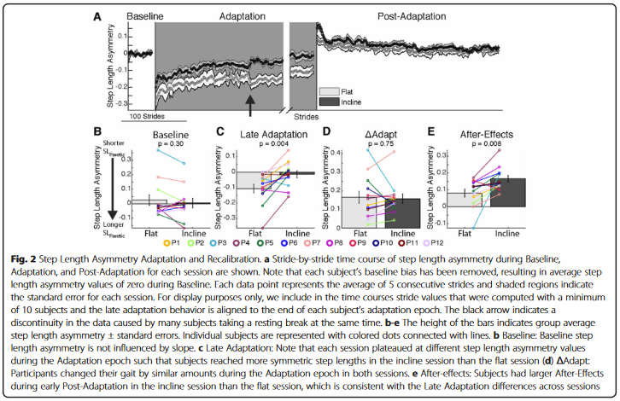
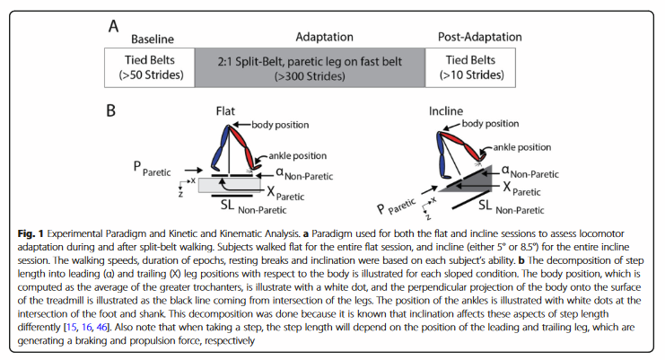
Other peoples’ split belt data

Slide 12
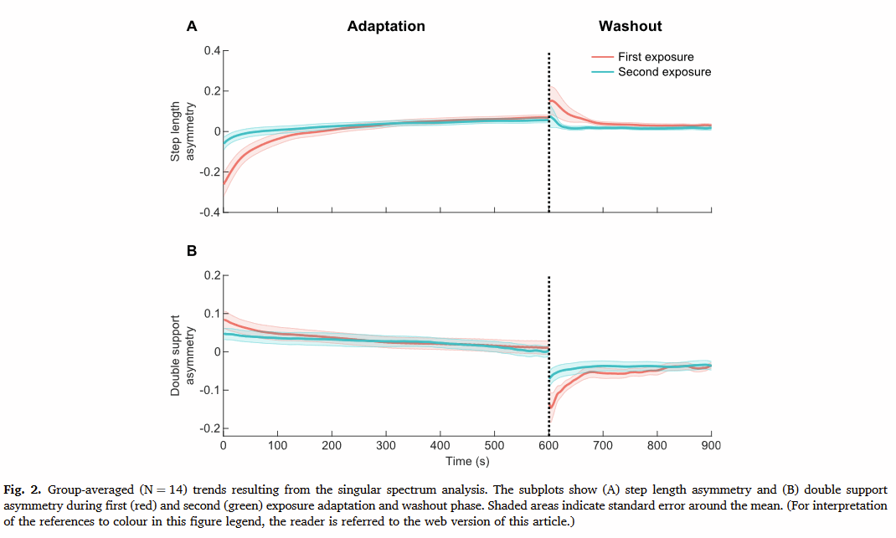
SSA walking and savings (3 wks analysis)
Buurke et al. 2022
Split-belt walking: an experience that is hard to forget
Noted that curves are very smooth - could be result of singular spectrum analysis
“SSA decomposes time-series data into components and reconstructs a trend, by identifying the associated slow-varying components and precluding the high-frequency residual components that represent noise.”
I think this (SSA) analysis + group averaging is why the curves are so weirdly smooth
Singular spectrum analysis (Hassani and Hossein, 2007: sIngular analysis: methodology and comparison)
Time series analysis incorporating classical time series analysis, multivariate statistics and geometry, dynamical systems and signal processing
It can find trends at different resolution, smooth data, extract seasonality components, extract cycles with small and large periods simultaneously, extract periodicity with different amp, structure in short time series, and detect change points.

